Slide 1
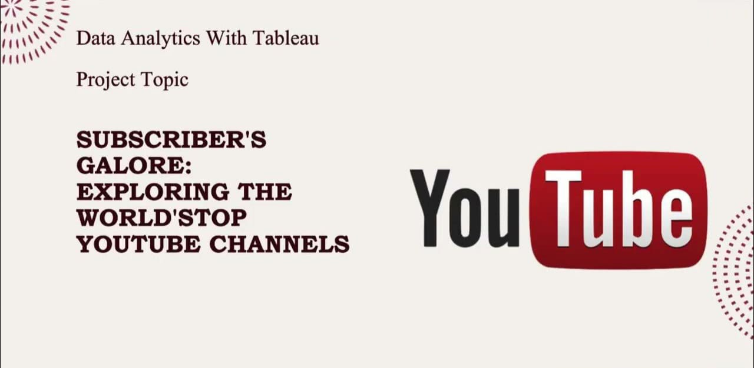
Subscribers galore: Exploring World’s Top Youtube Channels
Team leader: R.R. Reflin
Team members: S.V. Sanesha
J. Shalu Mol
G.B. Sherin

Slide 2
Project Report
1 Introduction
1.1 Overview
1.2 Purpose
2 Problem Definition & Design Thinking
2.1 Empathy Map
2.2 Ideation & Brainstorming Map
3 Result
4 Advantages & Disadvantages
5 Applications
6 Conclusion
7 Future Scope

Slide 3
Subscribers Galore: Exploring World’s Top Youtube Channels
1 INTRODUCTION
1.1 Project Description
“Subscribers Galore” is a project aimed at helping YouTube channels increase their subscriber count. It offers strategies, tips, and resources to assist content creators in gaining a larger audience. This project aims to showcase the world’s top You Tube channels as examples of success and to provide insights into their growth and content creation techniques.
1.2 Purpose
The purpose of the “Subscribers Galore” project is to serve as a valuable resource for content creators on You Tube who want to grow their channels. By showcasing the world’s top YouTube channels and providing insights into their strategies. It is to inspire and educate content creators by fostering community

Slide 4
and collaboration, enhancing channel growth through effective strategies, and providing data-driven insights, ultimately empowering creators to build successful YouTube channels and connect with a broader audience.
2 Problem Definition & Design Thinking
The world’s top You Tube channels often face challenges in maintaining and growing their subscriber base. The key problem is to identify and address the issues hindering subscriber growth and engagement. These challenges may include stagnant subscriber counts, declining views, or difficulties in retaining the existing audience.

Slide 5
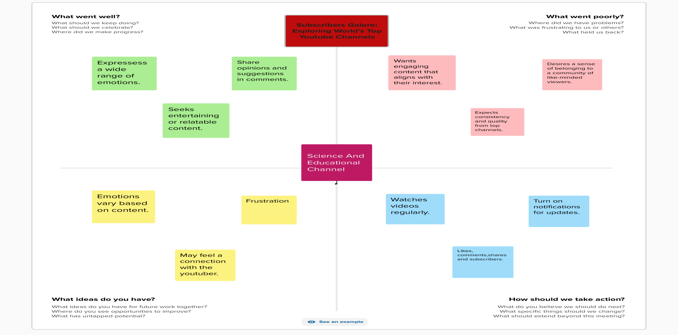
2.1 Empathy Map

Slide 6
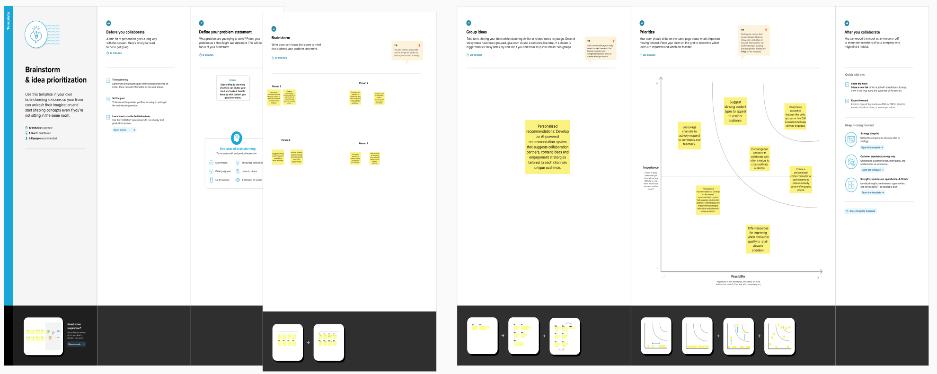
2.2 Brainstorming Map

Slide 7
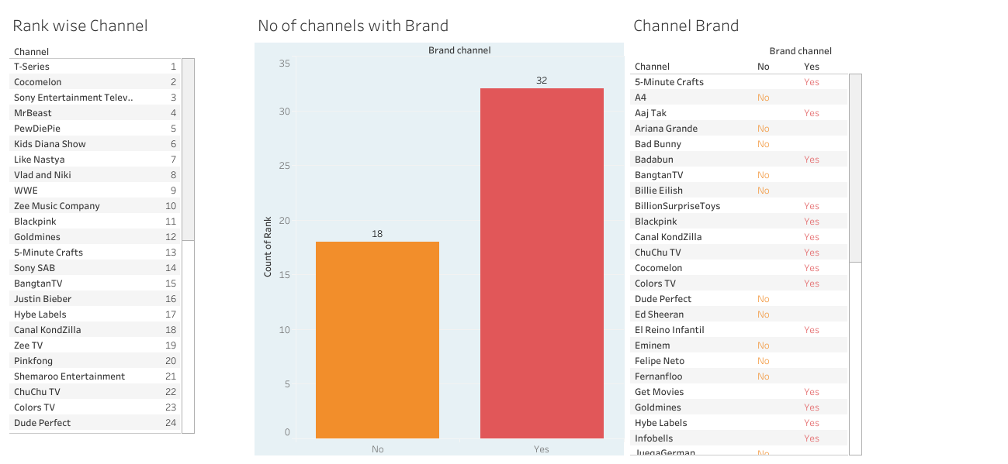
3. RESULT
Dashboard

Slide 8
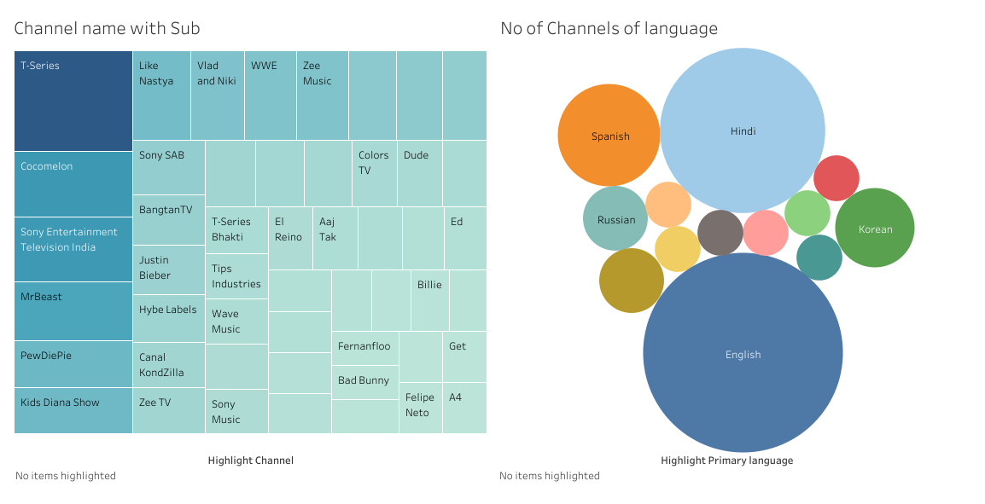

Slide 9
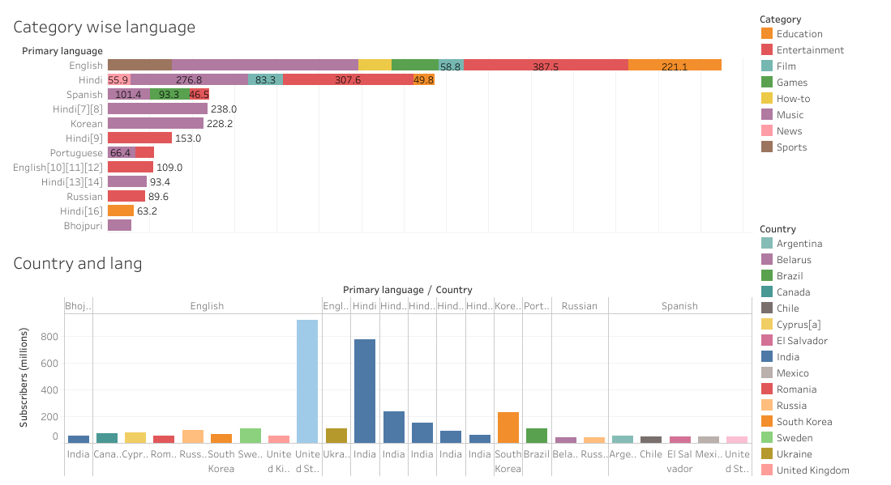

Slide 10
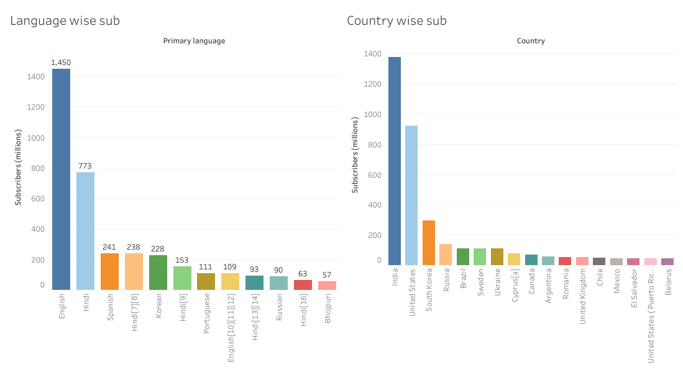

Slide 11
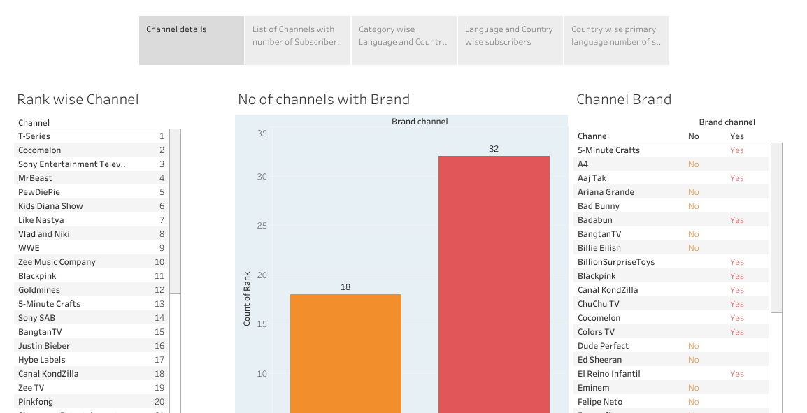
Story

Slide 12
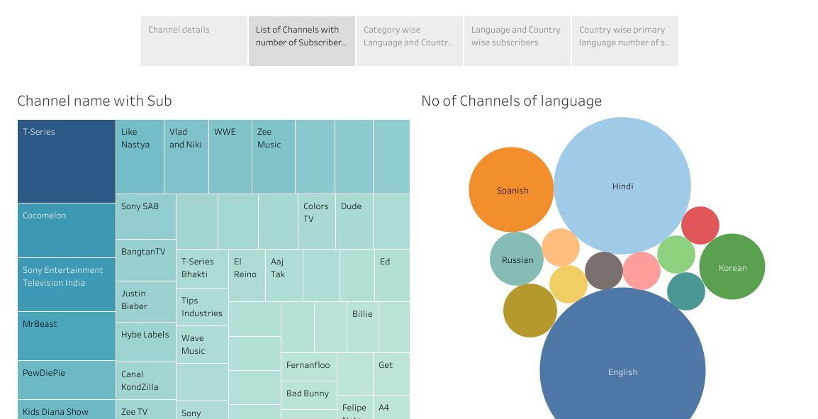

Slide 13
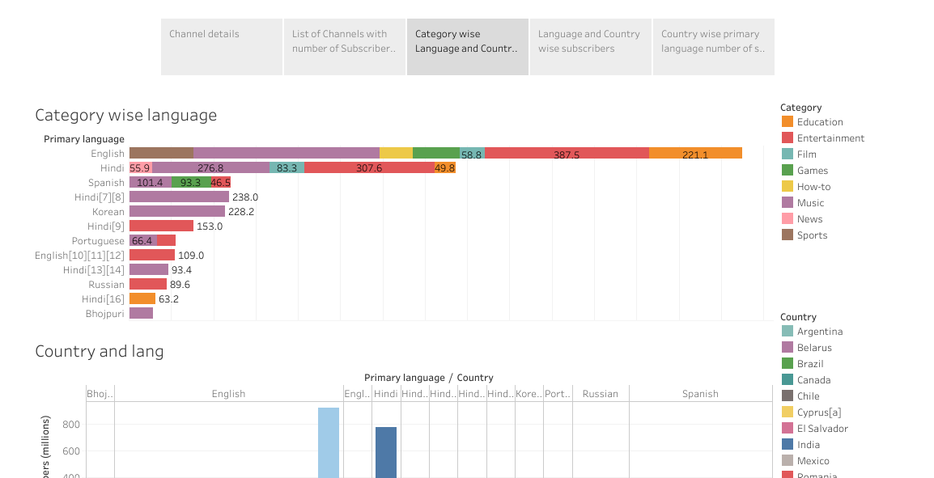
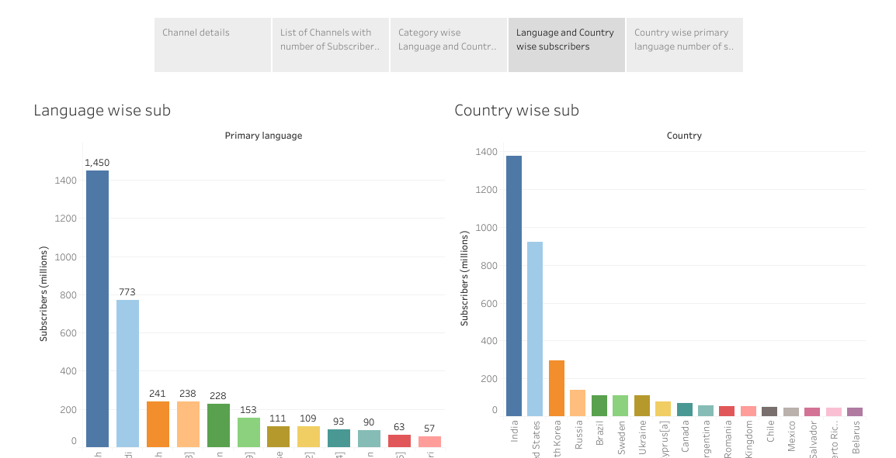

Slide 14
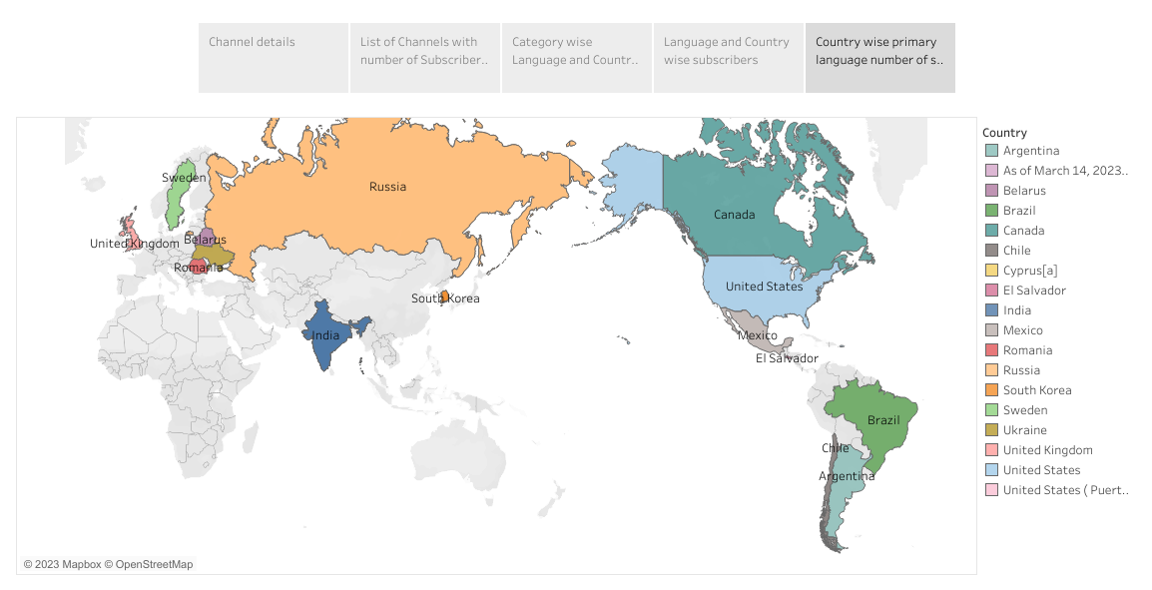

Slide 15
4 ADVANTAGES & DISADVANTAGES
Advantages
Customized Content:
Subscribing allows you to curate your YouTube experience. You receive videos from channels you're interested in, making it easier to find content that aligns with your preferences.
Notifications:
Subscribers often receive notifications when their subscribed channels upload new videos. This keeps you up to date with your favorite content creators.
Supporting Creators:
Subscribing is a way to support your favorite content creators. It can help them grow their audience, generate income through ads and sponsorships, and continue creating content.

Slide 16



Slide 17
Disadvantages
Content Overload:
Subscribing to too many channels can lead to a cluttered subscription feed, making it challenging to keep up with all the content.
Notification Overload:
If you receive notifications for every new video from your subscribed channels, it can become overwhelming and disruptive.
Privacy Concerns:
Subscribing publicly to certain channels can reveal your interests and viewing habits to others, potentially compromising your privacy.

Slide 18



Slide 19
5 APPLICATIONS
Entertainment and Media:
Popular YouTube channels are often a source of entertainment for millions of viewers. They can include music, comedy, vlogs, and more.
Education:
Many educational content creators have substantial subscriber bases. These channels offer tutorials, lectures, and informative content on various subjects.
Marketing and Advertising:
Understanding YouTube subscribers is crucial for marketers and advertisers. They may collaborate with popular channels for product placements or influencer marketing.

Slide 20
6 CONCLUSION
In conclusion, YouTube subscribers and the popularity of channels on the platform have a far-reaching impact across various domains. This metric isn't limited to the realm of entertainment; it extends to education, marketing, business, technology, and many other areas. The influence of popular YouTube channels has become a powerful force in shaping consumer behavior, disseminating information, and creating new opportunities for content creators and businesses. Understanding and harnessing the dynamics of YouTube subscribers is vital for anyone looking to engage with this diverse and influential online community.

Slide 21
7 FUTURE SCOPE
The future scope for YouTube and its top channels is incredibly promising. YouTube's dominance in the online video-sharing space shows no sign of diminishing. With the platform's continued expansion, it's expected that top channels will continue to thrive and evolve. First, as the global internet penetration and access to high-speed connections increase, YouTube's user base is likely to expand further, offering top channels the potential for even larger audiences. This is particularly significant in emerging markets, where a growing middle class and increased smartphone usage provide a vast audience for content creators.

